Slide 1

Desktop Assistant
User Manual
Author: Alexander Sakti
Notes:
Preworks course home assignments

Slide 2
Table of Contents
Acknowledgements
About me
About App
How to use the App
Demo Video

Slide 3
Acknowledgements
I would like to thank my parents, my mentor Mani, and Dr. Ken Kahn for providing me with this experience. This was made possible because of them.

Slide 4
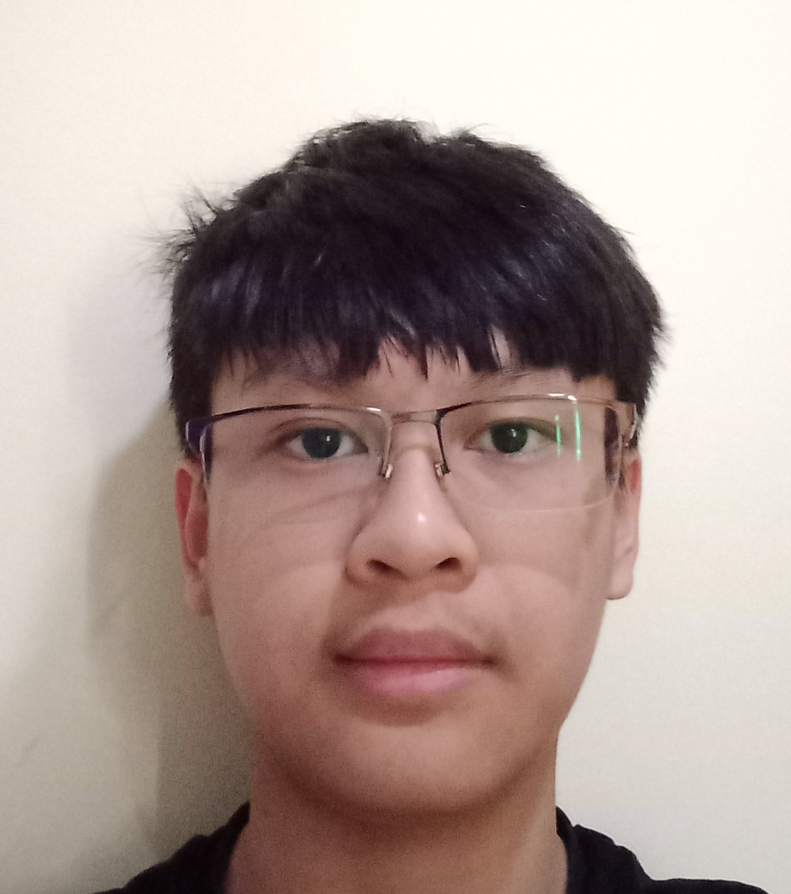
About Me..
I am Alexander Sakti, I am 15 years old and in grade 10.
I am currently interested in in programming, specifically app development using AI.
My Internship experience with Clevered was amazing and I believe it could help me in the future.

Slide 5
About App..
Desktop Assistant
This Desktop Assistant can listen for the user's command, then complete it whether it be opening an app or searching something.
The main menu consists of a start button and a close app button.

Slide 6
How do I use the App?
The app listens to the command, then performs it.
The start button is to start speaking to the assistant and give commands.
The program will keep repeating by itself and saying "stop the program" will end it.
The app has a limited number of responses available and may not detect the user's voice properly if the voice is not loud and clear.
The Close App button is used to close the entire app.

Slide 7
Demo Video
Demo any 2 features/ functions/ options of your project. Make a recording of the same and attach here as a backup if needed

Slide 8
Thank you!

